Slide 1
Single-mode fiber dispersion characterization with ultrabroadband white light spectral interferometry
PhotInd Prague 26.06.2018
Andreas Valdmann
Sandhra-Mirella Valdma
Heli Lukner
University of Tartu
Notes:
Kelle logod siin peavad olema? EMPIR? PhotInd

Slide 2
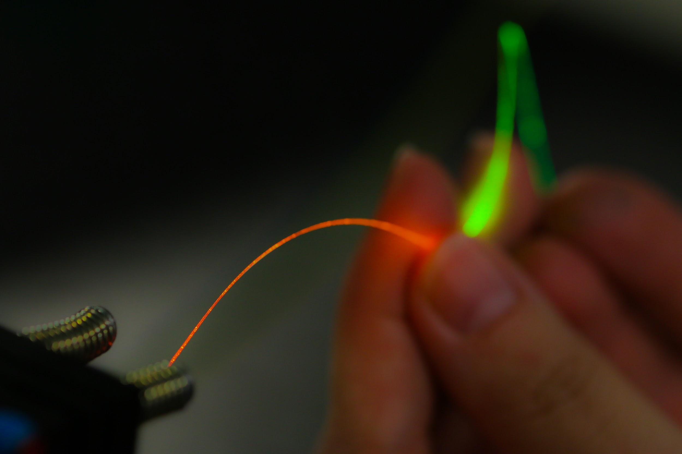
Methods
SEA TADPOLE interferometer
Results
Fiber dispersion measurements
Issues
Cladding modes
Lack of reference data
Conclusion and Outlook

Slide 3
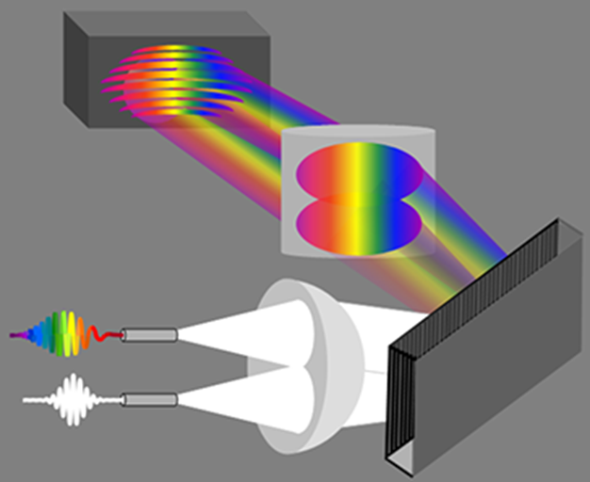
SEA TADPOLE
SEA TADPOLE spectral interferometer is used to find the relative spectral phase difference between two optical pulses.
Measuring the spectral phase difference between the input and output field of an optical fiber enables to characterize its dispersion.
Camera
Cylindrical lens
Unknown pulse
Fibers
P. Bowlan, P. Gabolde, A. Shreenath, K. McGersham, R. Trebino and S. Akturk, Opt. Express, vol. 14, p. 11892-11900 (2006)
Reference pulse
Lens
Grating

Slide 4
SEA TADPOLE for fiber dispersion characterization
Fused silica rods for dispersion compensation
AC lens
Photonic crystal fiber
(PCF)
Measured fiber
Spectro-meter
AC lens
PCF
428-1088 nm

Slide 5
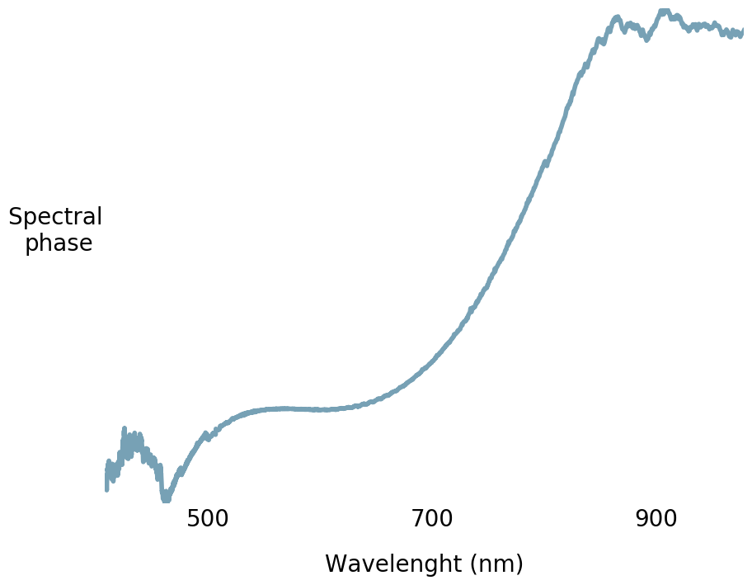
Spectral phase can be retrieved from the camera image
Wavelength (nm)
Camera image

Slide 6
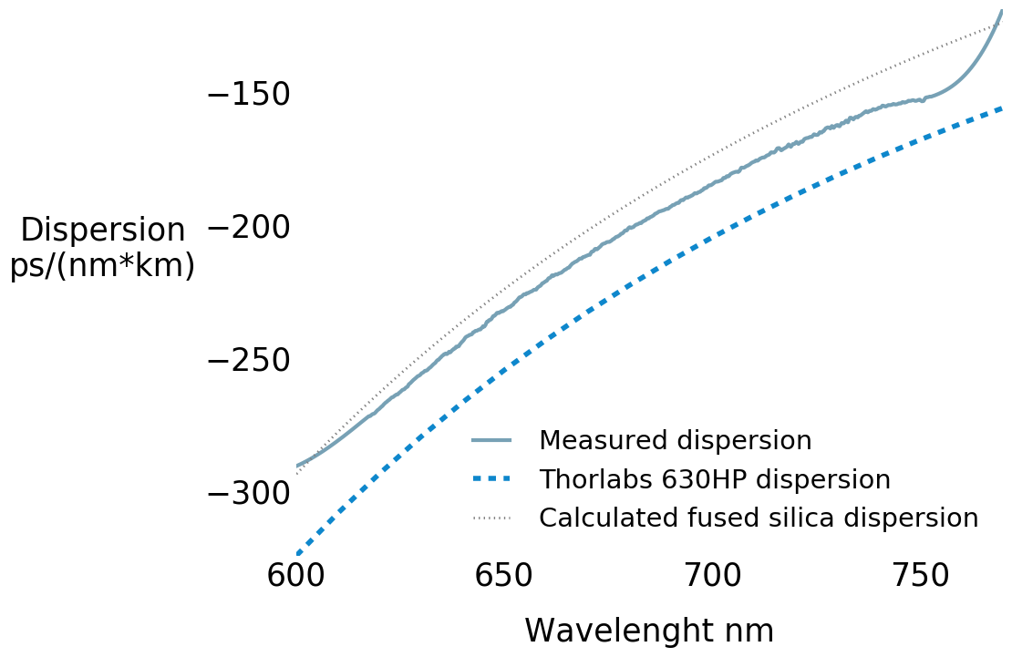
Fiber dispersion is calculated from the spectral phase
Wavelength (nm)
Wavelength (nm)

Slide 7
Test fiber
Thorlabs 630HP single-mode (600 - 770 nm) optical fiber
Mode field diameter:
4.0 ± 0.5 µm
Reference dispersion data from Thorlabs

Slide 8
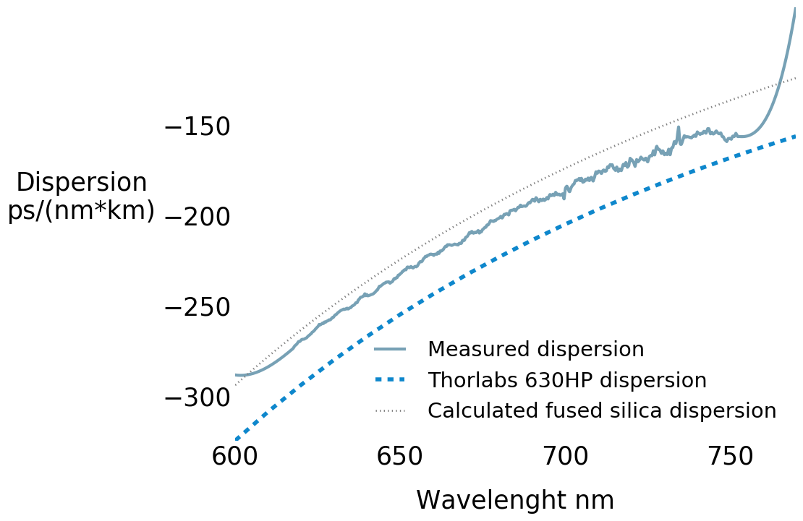
Results 1: Measurements of the same piece of the fiber
Sample 1.1
Sample 1.2
Wavelength (nm)
Wavelength (nm)
The fiber was cut a few mm shorter between the measurements, hence the numbering 1.1 and 1.2.

Slide 9
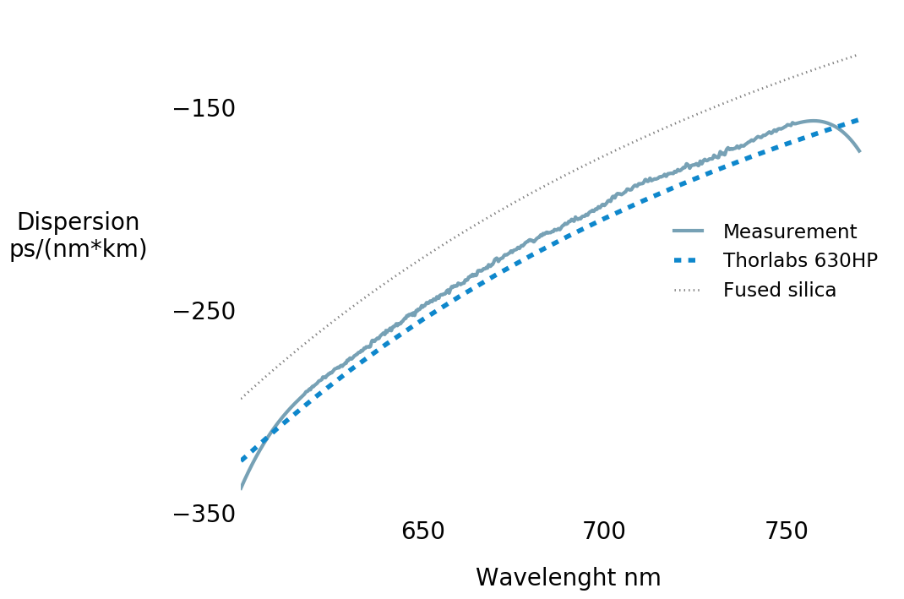
Results 2: Two different pieces of fiber from the same spool
Sample 1.2
Sample 2.1
Wavelength (nm)
Wavelength (nm)

Slide 10
Issues 1: measurement noise caused by cladding modes
Broadband spectrum reduces fiber coupling efficiency
More light propagates in cladding modes
Longer fiber is needed to suppress cladding modes
Better dispersion compensation is needed to stay in the phase measurement range of the system

Slide 11
Issues 2: not enough reference data
Problem: the Thorlabs dispersion data comes without uncertainty estimates. We cannot say if the variations in our measurement results come from our system or from the fibers.
Solution: well-characterized test fibers are needed.
Note: in addition to fiber dispersion, we can also measure the effective refractive index. However, no reference data is available. Providing reference data for refractive index dispersion via modelling or independent measurements would help to verify our method.

Slide 12
Conclusion
We found out that the dispersion of the fiber varies considerably depending on the part of the fiber spool used.
We saw only a small variation in the measurements when same fiber was cut shorter for subsequent measurements.
Test fibers with comprehensive reference data are needed to verify the method.

Slide 13
Outlook
Verify the results with different known single mode fibers.
In the future we would like to decrease the noise even further in the spectral interferogram by suppressing the cladding modes.
Also we would like to investigate the possibility of measuring dispersion of higher modes.
Develop the setup for telecom wavelengths.

Slide 14
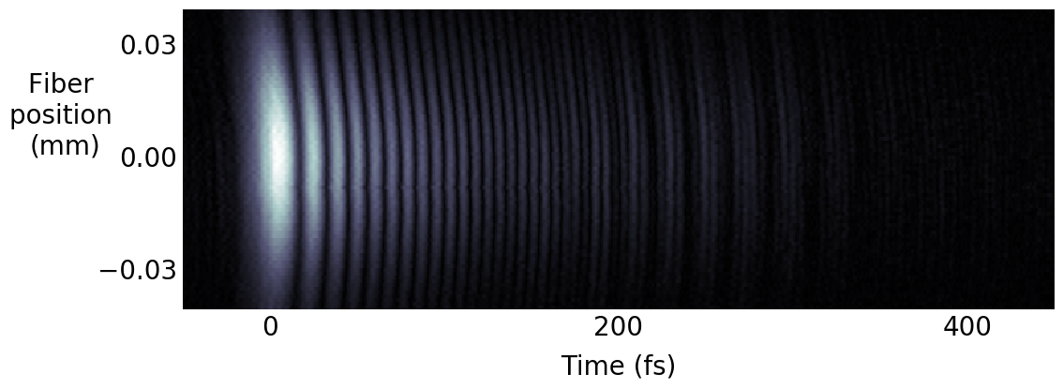
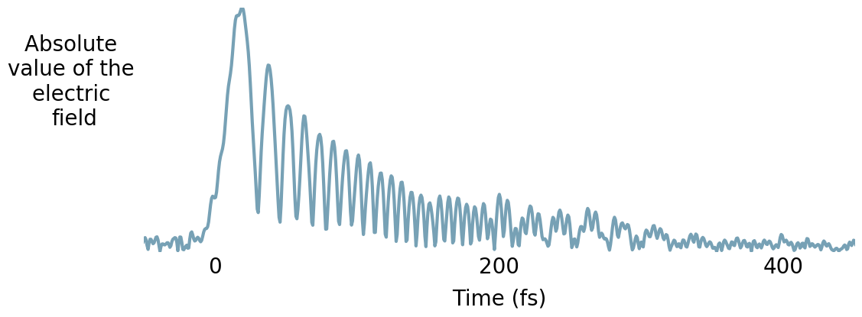
One can also scan the pulse in x-y and resolve it in time
10

Slide 15
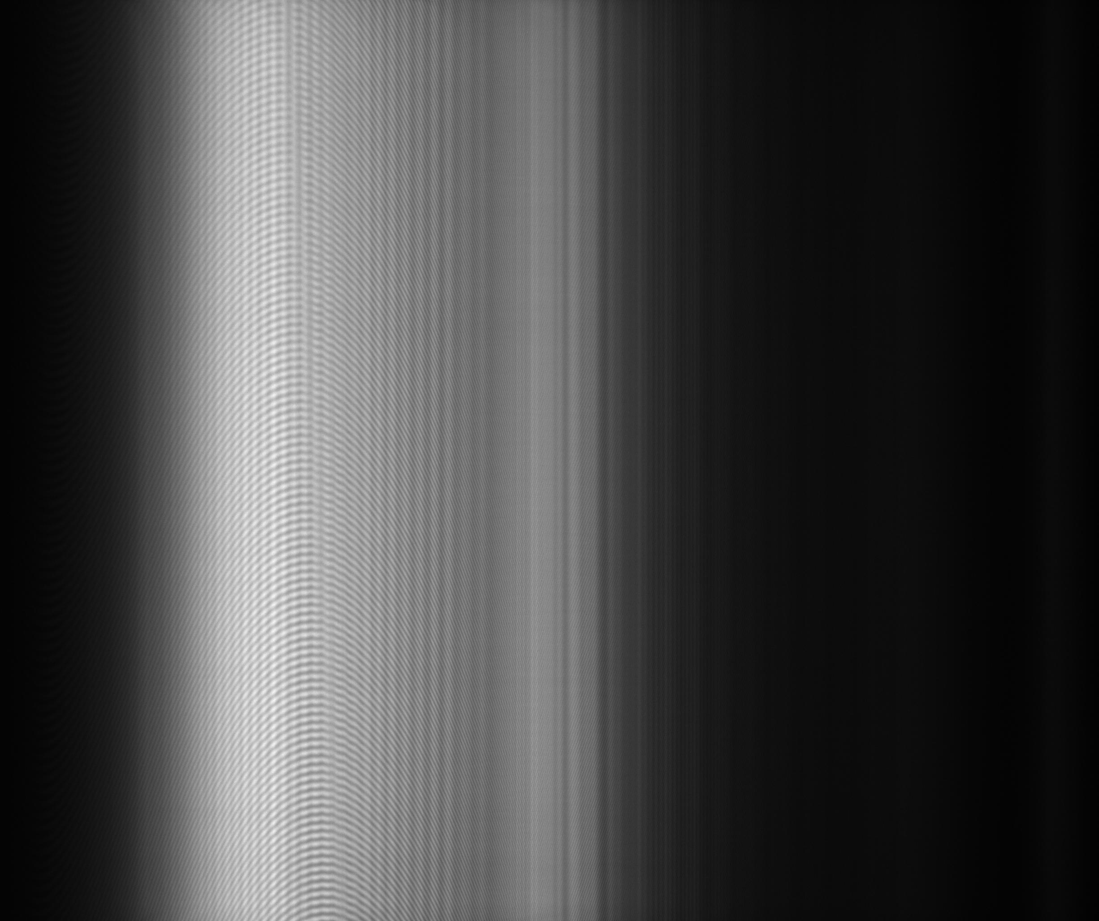
Measurements provide spatial-spectral interferogram
8

