Slide 1
PhotInd WP 1 task 2
Aigar Vaigu
VTT
26th of June 2018

Slide 2
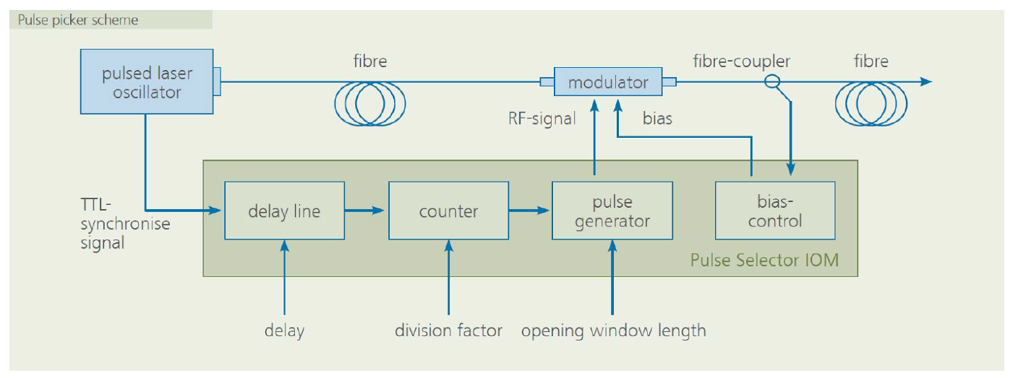
A1.2.1
Pulse picker has been tested and connected to the setup.
Due to the spectrally wide pulse the suppression of the pulses is orders of magnitude worse than expected, but still usable.

Slide 3
A1.2.2
Monochromator is connected to the setup.
Monochromators electronics and software updated.

Slide 4
A1.2.3 and A1.2.4
After several attempts we finnaly succeeded. The setup was compleatly redesigned.
Notes:
The free-space and free running detectors need to be purchased.

Slide 5
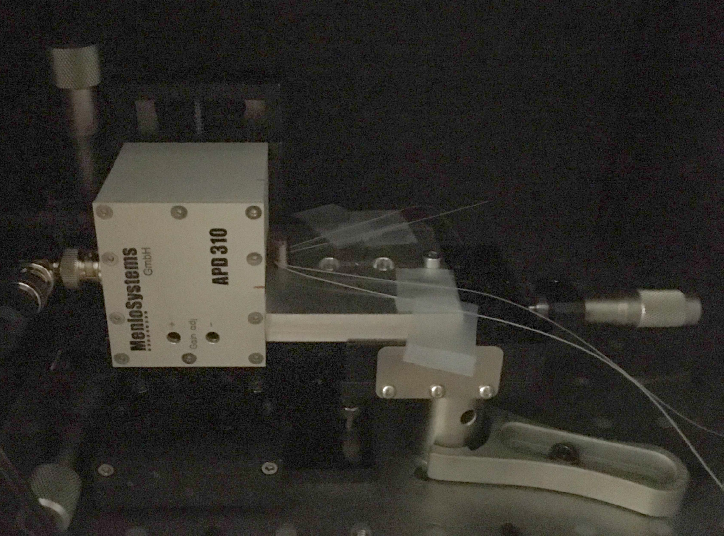
APD
Front fibre
Back fibre

Slide 6
The light source characteristics

Slide 7
A1.2.7
Under preparation.
Waiting samples from METAS

Slide 8
Thank you!

