Slide 1
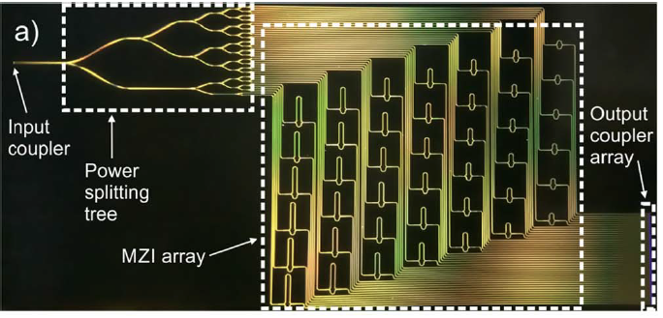
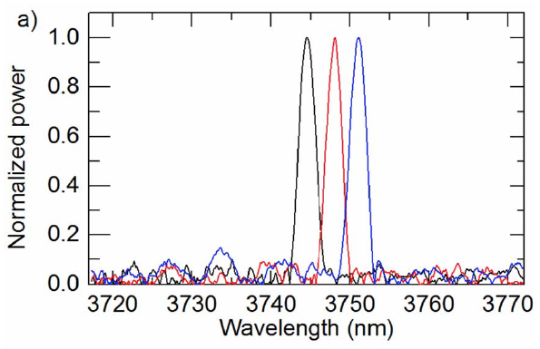
2.3. Metrology in waveguide-based photonic devices (CSIC)
A.2.3.1. Novel Fourier Transform Micro-spectrometers
Mid-IR spectrometer:
Spatial Heterodyne Fourier Transform (SHFT) spectrometry scheme has been successfully adapted to the mid-IR in collaboration with University of Southhampton.
PENDING: Athermal SHFT spectrometer through sub-wavelength gratings.
Main goal of the last period of the project (schedule relocated as the original Gantt chart was incorrect).
JCM collaboration.
PUBLICATIONS:
Mid-IR published in IEE Photonic Technology Letters.
Related results presented in 11 invited conferences in 2016-2017.

Slide 2
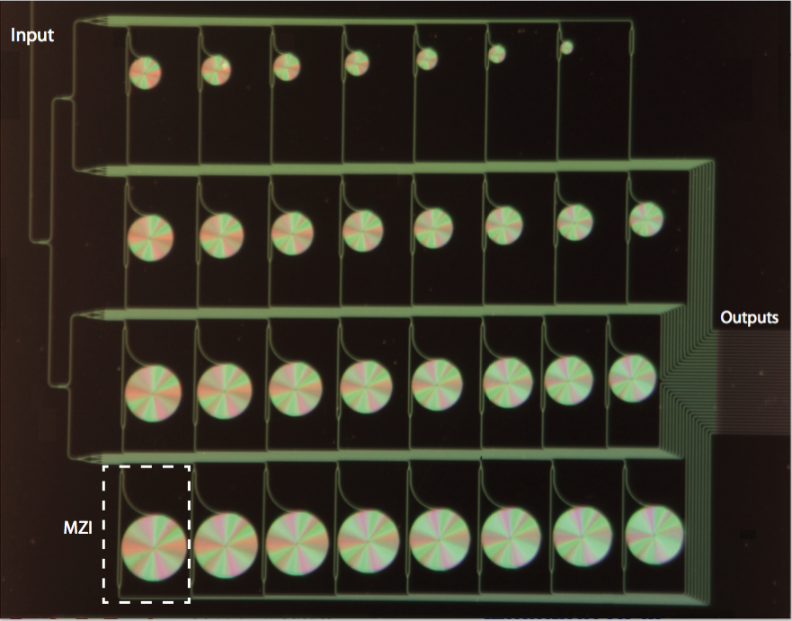
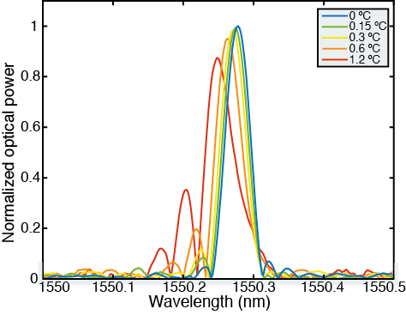
2.3. Metrology in waveguide-based photonic devices (CSIC)
A.2.3.2. Novel algorithms for Microspectrometer spectral retrieval
We have developed two novel software athermalization techniques.
We have developed a novel compressive sensing technique to reduce the number of required interferometers.
Thanks to the new algorithms, we have demonstrated a 17 pm resolution in a device with 20 mm² footprint.
Early results published in national journal (OPA).
Two Optic Letters publications.

Slide 3
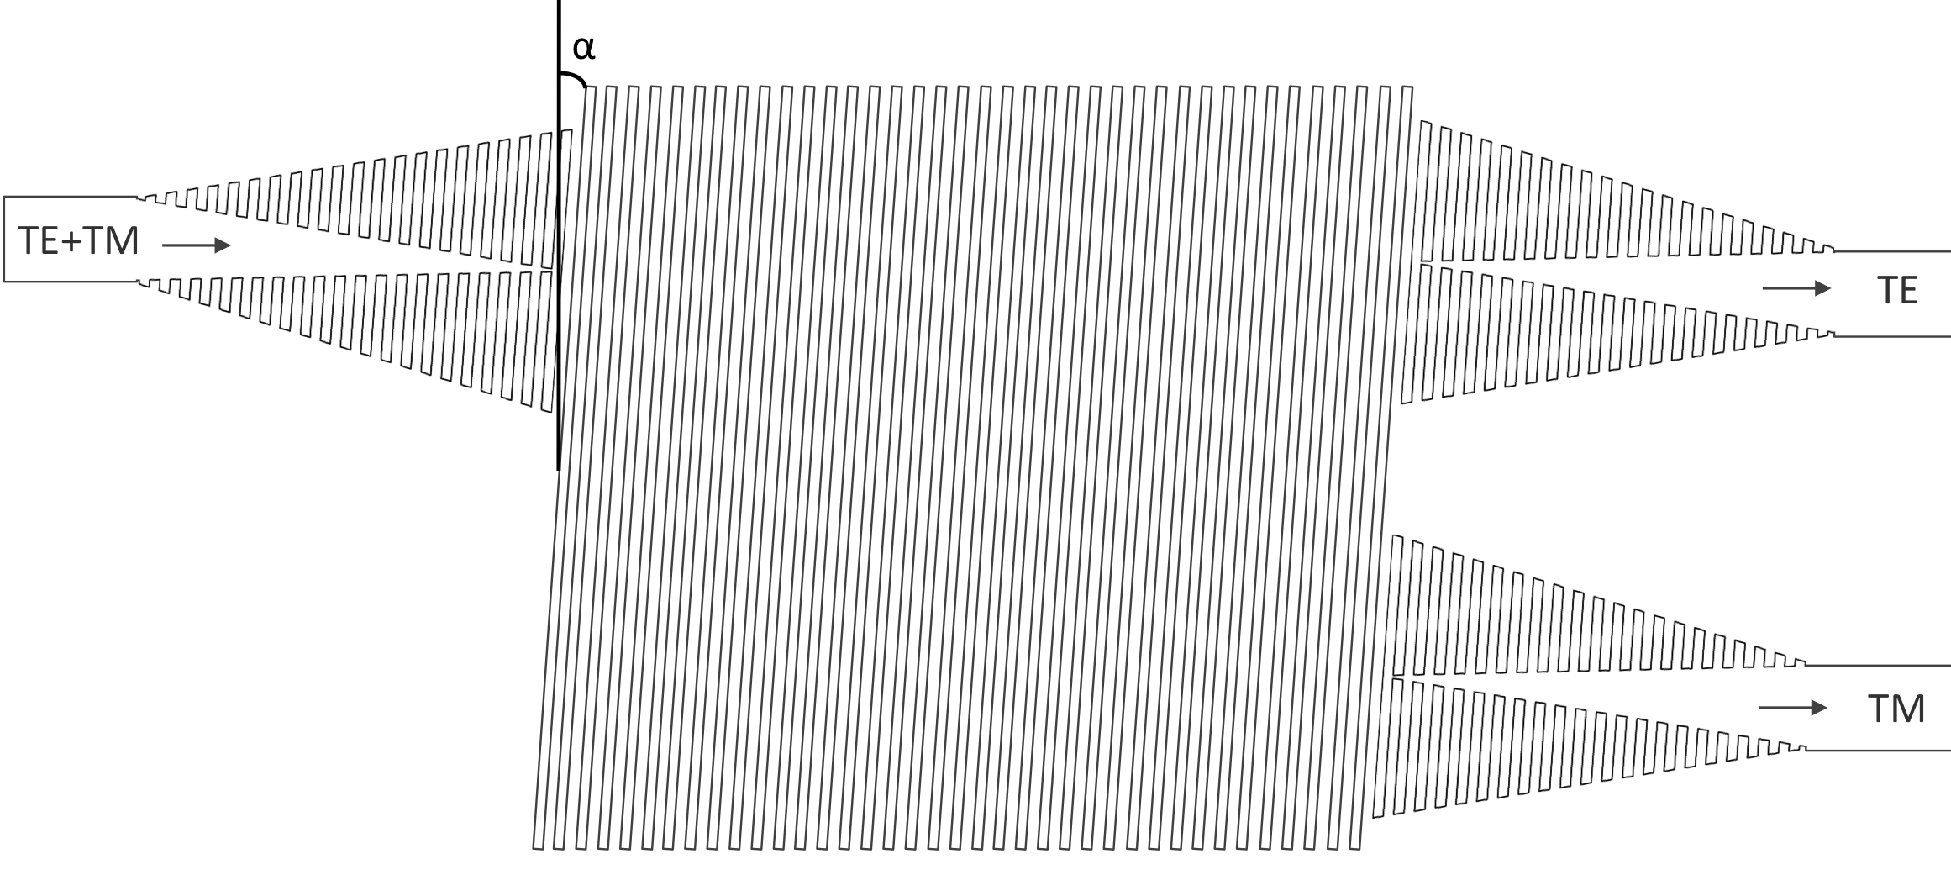
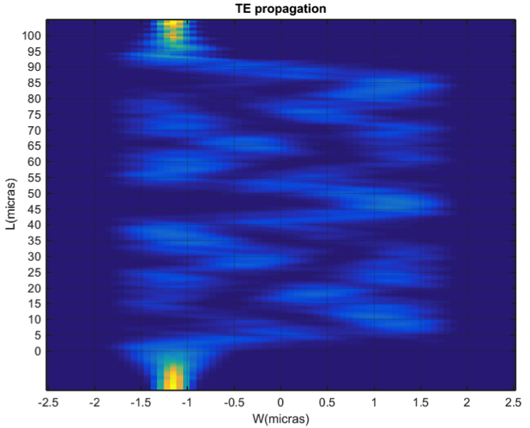
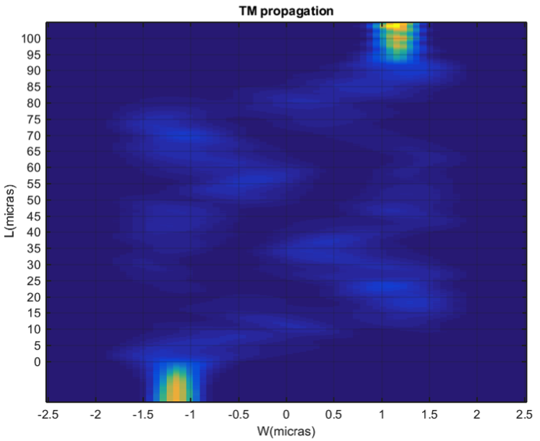
2.3. Metrology in waveguide-based photonic devices (CSIC)
A.2.3.3. Ultracompact polarization converters
After studying the viability of several configurations based on subwavelength trenches, we ended up developing a polarization splitter based on an MMI with rotated SWG gratings.
Simulations show high extinction ratio in a compact device.
Patent and publication in following months.

Slide 4
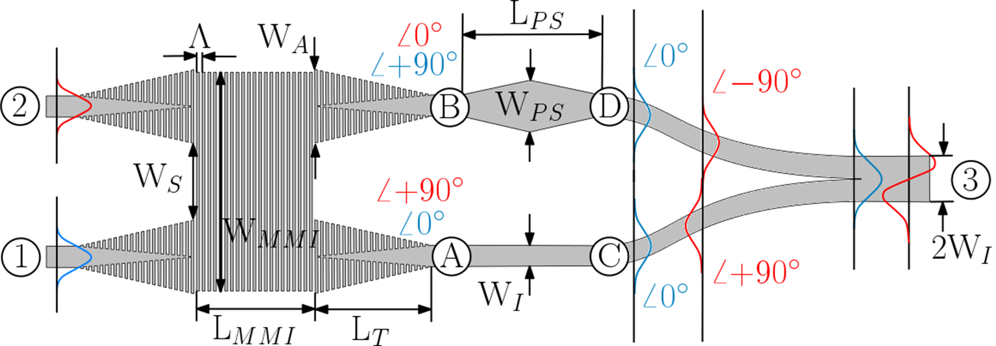
2.3. Metrology in waveguide-based photonic devices (CSIC)
A. 2.3.4. Fabrication tolerance analysis
A. 2.3.5. Temperature effect analysis
Other: a novel ultra-broadband (>300 nm) optical mode multiplexer has been designed and fabricated (partially related to activities 2.2, 2.3.3. and 2.3.4.).
Patent and publication in following months.
Already performed in parallel to 2.3.1 and 2.3.3
Extinction ratio

Slide 5
2.3. CONCLUSIONS
M27
3 High-impact papers
1 national paper
M36 expectations
3 additional papers
2 patents
Main pending task is spectrometer athermalization with JCM collaboration.

