Slide 1
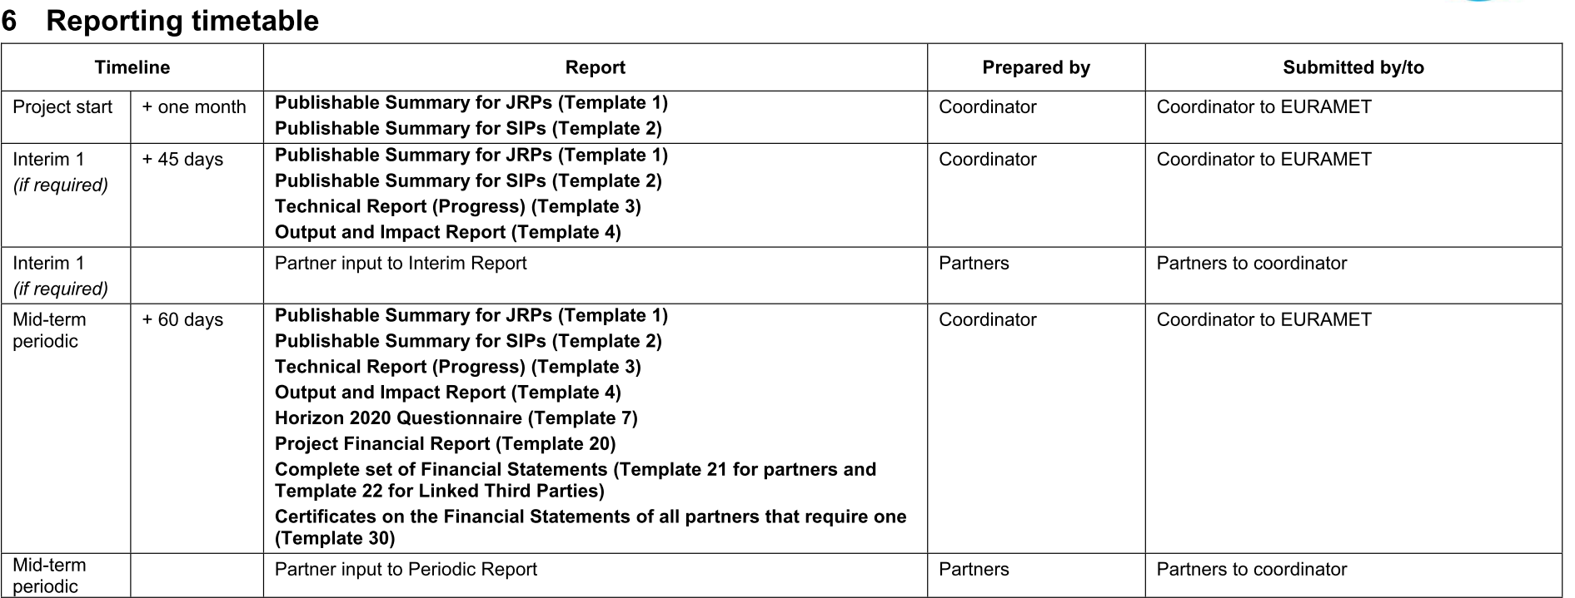
Reporting
9M, 27M
18M

Slide 2
Reporting process for 9M interim report
Co-ordinator sends prefilled forms for partners => 2 May 2016
Technical Report (TR)
Output and Impact Report (OIR)
Task leaders fill in progress in each tasks (TR chapter 3 and 4) (if needed ask help from other partners contributing) to WP leaders => 16 May 2016
WP & deliverable leaders finalised chapter 3 and 4 and fill in progress towards deliverables (TR chapter 2.2) => 30 May 2016
All partners fill Output and Impact Report (OIR) and send the it to coordinator => 16 May 2016
Co-ordinator finalises documents and Publishable summary and sends them to MSU => 15 June 2016

